Slide 1


Rutvij Bhatt
May 16th, 2023

Slide 2

Outline
Executive Summary
Introduction
Methodology
Results
Conclusion
Appendix

Slide 3
Summary of methodologies on SpaceX data
Data Collection using SpaceX API and Web Scraping
Data Wrangling
Exploratory Data Analysis (EDA) with SQL
EDA with Data Visualization
Interactive Visual Analysis and Dashboard using Folium and Plotly Dash
Training and Prediction
Summary of all results
Data Exploration Results
Data Visualization Results
Prediction (Classification) Result
Executive Summary

Slide 4
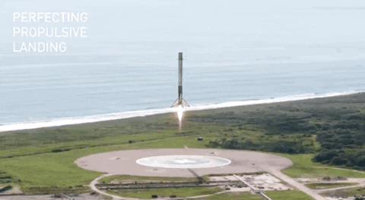
Introduction
Project background and context
SpaceX promotes its reusability of the first stage of a Falcon9 rocket launch, results in significant reduction in the cost for a launch as compared to other competitors in the market.
Thus, we need to determine the possibility of the first stage to be landed successfully, therefore the total cost of the rocket launch can be estimated. It helps for the competitors to bid against.
Problems you want to find answers
To predict the possibility of the first stage of a Falcon9 rocket to be landed successfully based on the launch data published on the SpaceX site.

Slide 5

Section 1

Slide 6

Methodology
Executive Summary
Data collection methodology
Description of how data was collected
Perform data wrangling
Description of how data was processed
Perform exploratory data analysis (EDA) using visualization and SQL
Perform interactive visual analytics using Folium and Plotly Dash
Perform predictive analysis using classification models
How to build, tune, evaluate classification models

Slide 7

Data Collection
Description of how SpaceX Falcon9 launch data sets were collected:
Launch records were collected using two sources:
SpaceX REST API
Using Web Scraping from the Wiki.
SpaceX REST API: A request to the Falcon9 launch data was made using GET, and a response was collected and parsed in the form of a JSON object, later to be converted in the Pandas dataframe.
From the Wikipedia page using Web Scraping: With the help of the BeautifulSoup library, a HTML table comprised of the launch records was extracted from the page ‘List of Falcon 9 and Falcon Heavy launches’, parsed and converted into the Pandas dataframe.

Slide 8

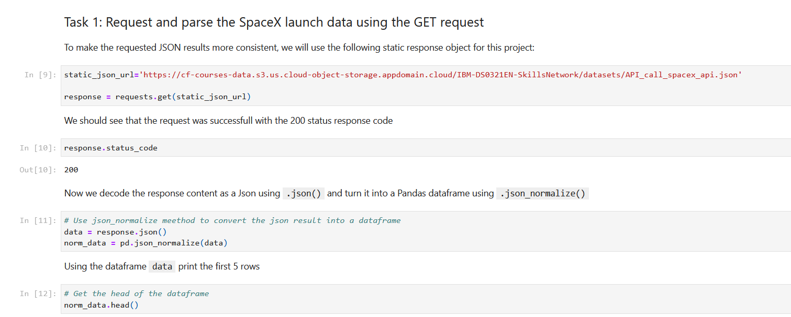
Data Collection – SpaceX API
Data collection using REST API to the SpaceX Falcon9 launch data:
A request was made, and a response was received using GET and was parsed into the JSON object later to be converted into a Pandas dataframe.
GitHub URL of the completed SpaceX API calls notebook.

Slide 9
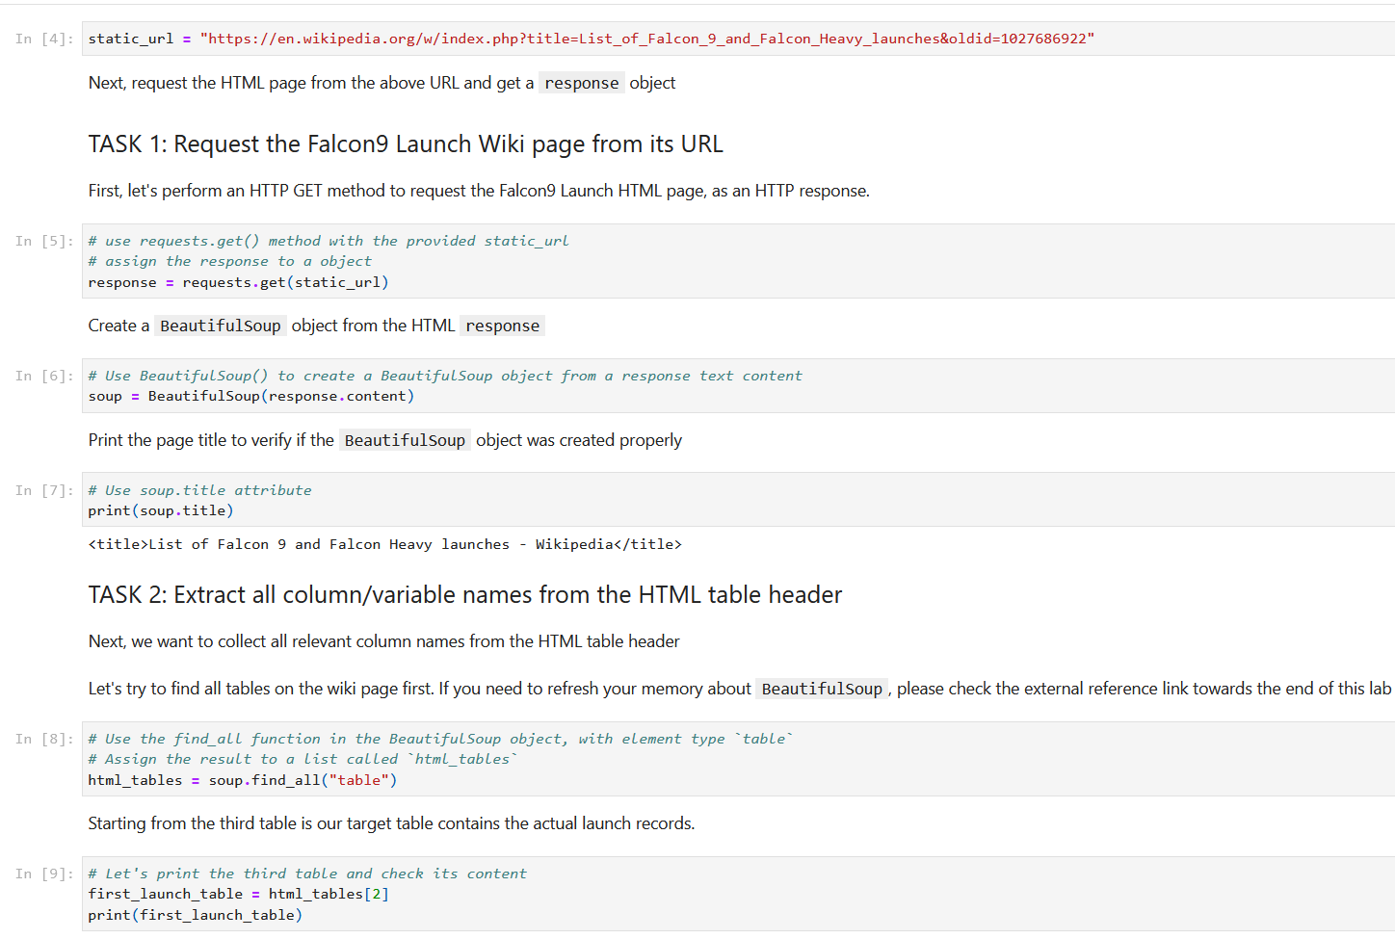
Data Collection - Scraping
Web Scraping to collect historical data of Falcon9 Launches:
With the help of the BeautifulSoup library, a HTML table comprised of the launch records was extracted from the page ‘List of Falcon 9 and Falcon Heavy launches’, parsed and converted into the Pandas dataframe.
GitHub URL of the completed web scraping notebook.

Slide 10
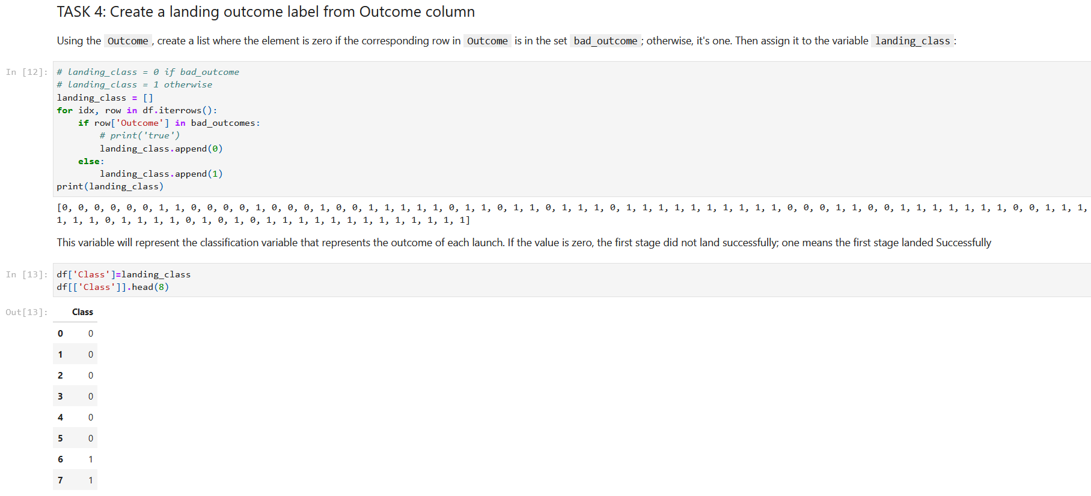
Data Wrangling
As the data was collected in a Pandas dataframe, next the data cleaning was done. As the data has all the launches, we had to filter only data related to Falcon9, it was done using BoosterVersion column.
This newly filtered dataframe has all the records of the Falcon9 launches, however, some information was missing in the attribute LandingPad.
Depended variable such as landing outcome was determined, and associate column was added named Class consist of all the labels for training the model.
GitHub URL of the completed data wrangling related notebook.

Slide 11
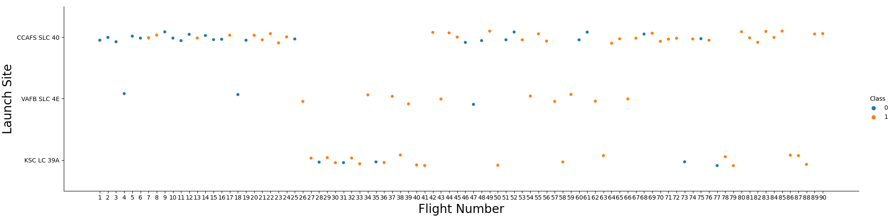
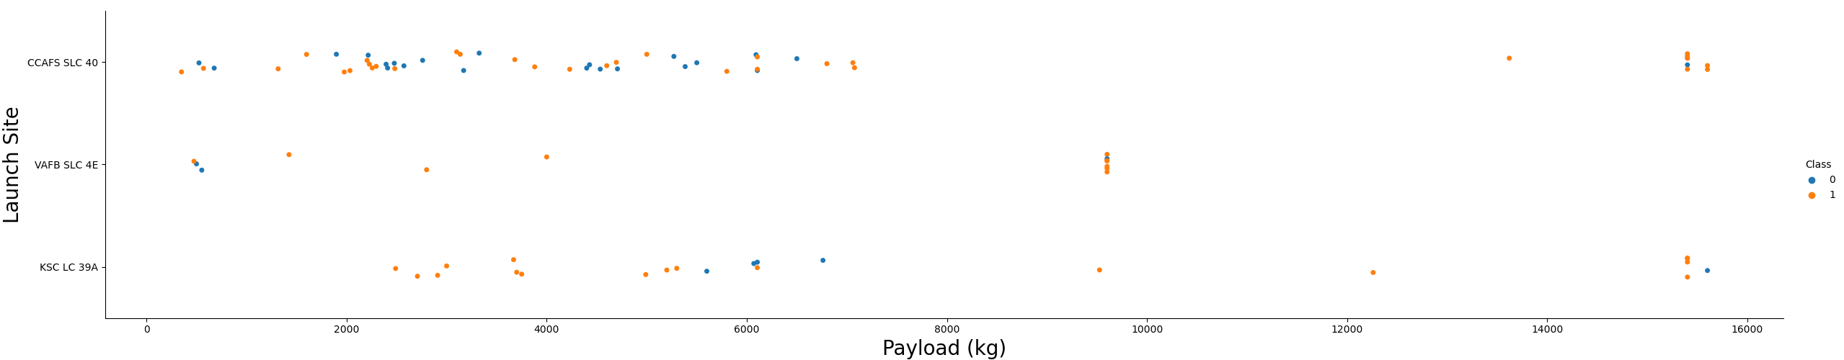
EDA with Data Visualization
Data Visualization is done using Matplotlib.
EDA is performed and insights are displayed using various plots.
Scatter Plots:
Relationship between Launch Site and Flight Number
Relationship between Payload and Launch Site
Relationship between Flight Number and Orbit Type
Relationship between Payload and Orbit Type
Bar Chart:
To illustrate the success rate of each orbit type
Line Plot:
Depicts successful launches per year
GitHub URL of the completed EDA with data visualization notebook.

Slide 12
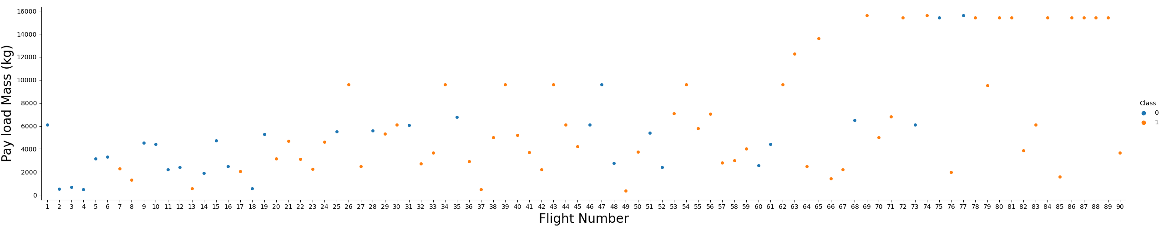
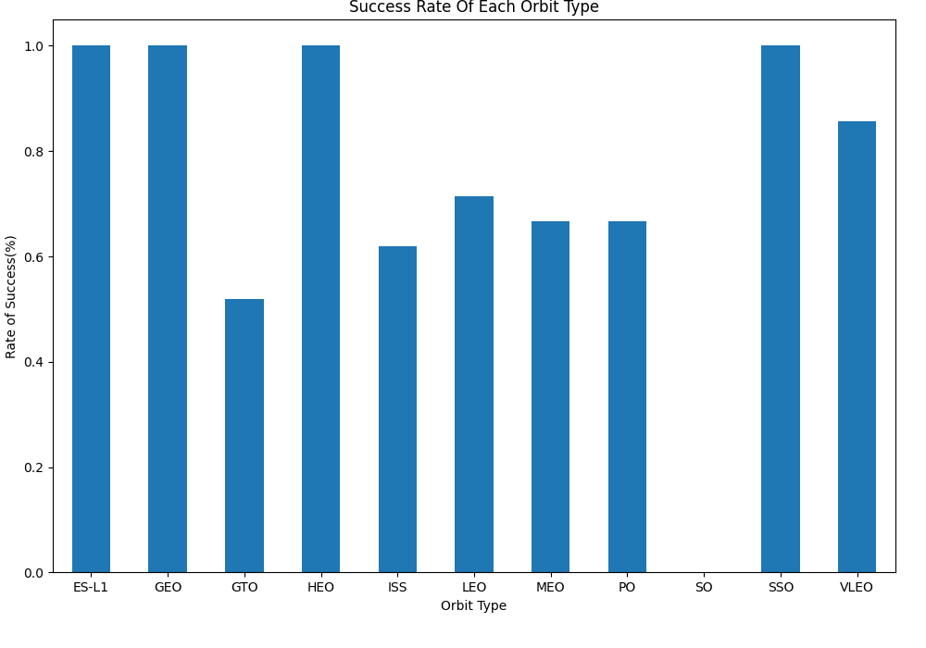
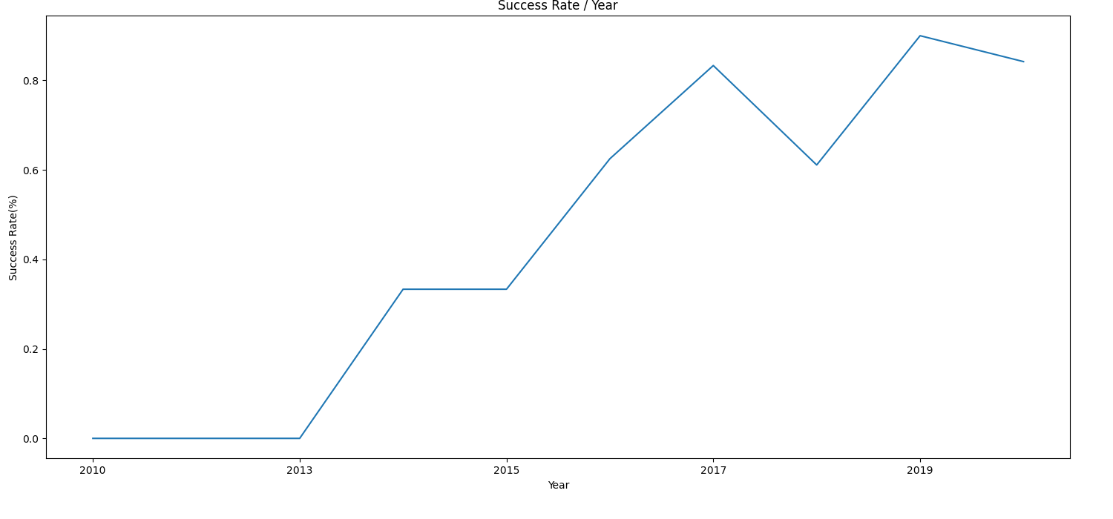
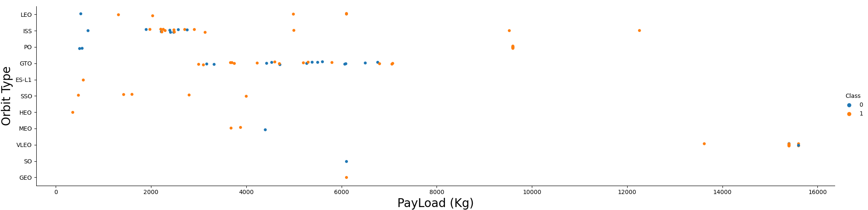
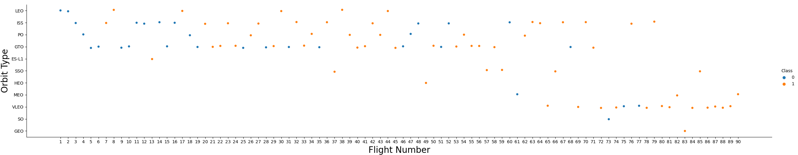
EDA with Data Visualization (Cont.)

Slide 13
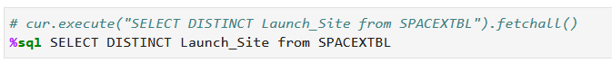
EDA with SQL
Queries performed for Exploratory Data Analysis are as follows:
Display the names of the unique launch sites in the space mission
Display 5 records where launch sites begin with the string 'CCA'
Display the total payload mass carried by boosters launched by NASA (CRS)
Display average payload mass carried by booster version F9 v1.1

Slide 14
EDA with SQL (Cont.)
List the date when the first succesful landing outcome in ground pad was acheived.
List the names of the boosters which have success in drone ship and have payload mass greater than 4000 but less than 6000
List the total number of successful and failure mission outcomes
List the names of the booster_versions which have carried the maximum payload mass.
GitHub URL of the completed EDA with SQL notebook.

Slide 15

Build an Interactive Map with Folium
Folium map objects such as markers, circles and lines are used to mark all the launch sites and success and failures of each launch performed through such sites.
Also, it is used to create outcome sets such as (failure = 0 or success = 1).
GitHub URL of completed interactive map with Folium map.

Slide 16
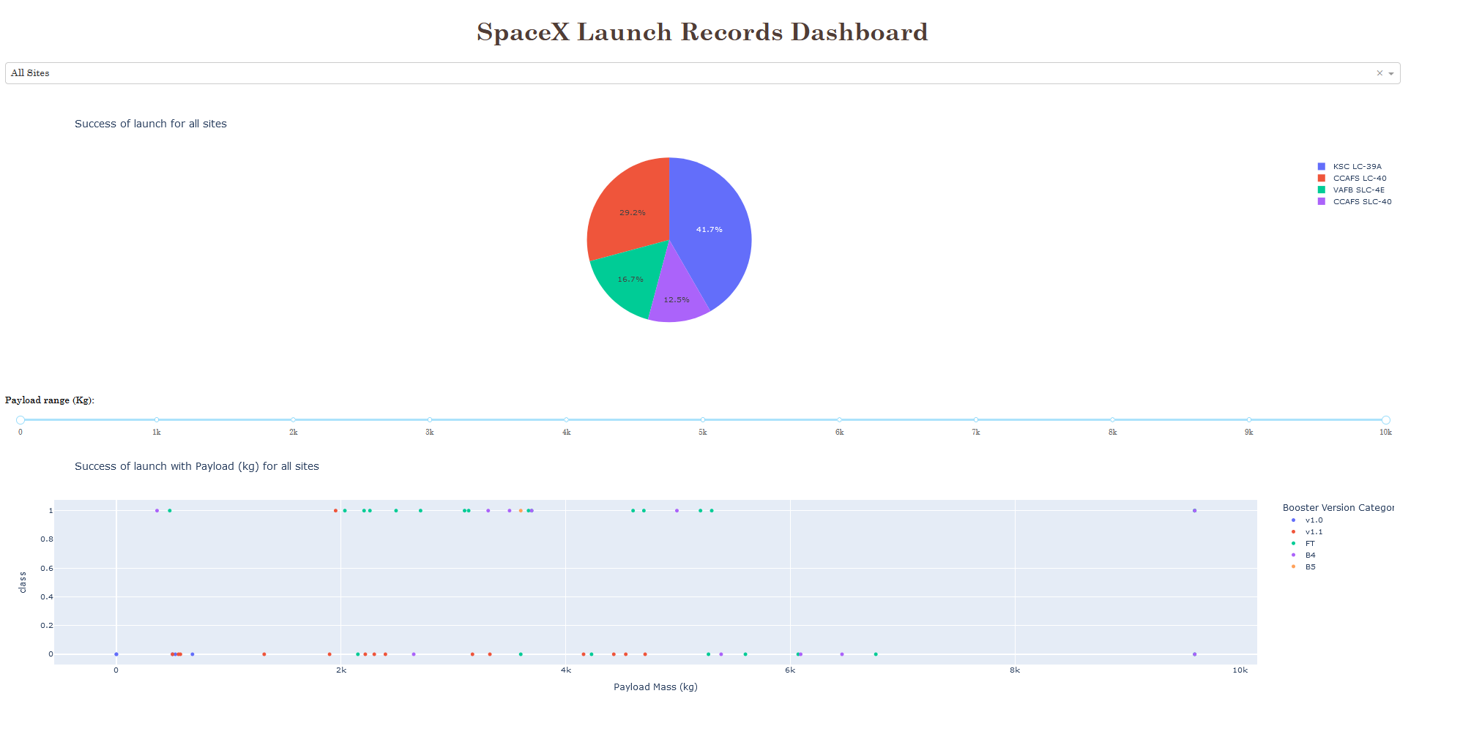
Build a Dashboard with Plotly Dash
An interactive dashboard application is created using Plotly dash and following modules were added:
A drop-down component for launch site selection.
A call back function to display a pie-chart of success for launches from the selected launch site from the drop-down.
A range slider to select Payload between certain range.
A call back function to display the scatter-plot for launches based on the mentioned attributes such as launch sites, and payload range.
GitHub URL of Plotly Dash lab.

Slide 17
Predictive Analysis (Classification)
Summary of the predictive analysis is as follows:
Performed Exploratory Data Analysis and determined Training Labels
Created a column for the ‘’class’’.
Standardized the input data
Split into training data and test data
Found the best Hyperparameter for SVM, Classification Trees , K nearest neighbors and Logistic Regression
Found the method that performed best using test data
The complete flow is as follows:
First, a pandas dataframe was created and labels for the training data were determined by creating a Numpy array from the “Class” column of the data using to_numpy() method and it was assigned to a variable Y.
Then using preprocessing.StandardScaler() function from Sklearn, dataset was standardized.
Dataset was split into train-test parts using train_test_split from the sklearn.model_selection and test size is set to 0.2 with random_state equal to 2.
Finally, to find best suited model among SVM, Classification Tree, K Nearest Neighbors, and Logistic Regression, object of each of them was created along with GridSearchCV object.

Slide 18
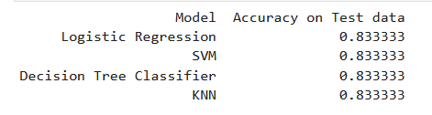
Predictive Analysis (Classification)(Cont.)
GridSearchCV object was created and parameter cv was set to 10. Training data was fitted to this object for each of the algorithms under evaluation to obtain best hyperparameters for each of them.
Result was the GridSearchCV object for each of the models and best parameters was displayed using best_params_ followed by respective accuracy on training set using best_score_.
At the end, accuracy on the test data was obtained using score method and confusion matrix was created to show actual and predicted results on test data.
Following is the accuracy score of each model on testing data:
GitHub URL of completed predictive analysis lab.

Slide 19
Results
Exploratory data analysis results
Interactive analytics demo in screenshots
Predictive analysis results

Slide 20

Section 2

Slide 21
Flight Number vs. Launch Site
With increasing flight number, failure rate decreases significantly. For launch sites KSC LC 39A and CCFS SLC 40, success rate becomes 100% after flight number 77.
While, in launch site VAFB SLC 4E, success rate is 100% after flight number 50.

Slide 22
Payload vs. Launch Site
If you observe Payload Vs. Launch Site scatter point chart you will find for the VAFB-SLC launch site, there are no rockets launched for heavy payload mass(greater than 10000).

Slide 23
Success Rate vs. Orbit Type
Orbits ES-L1, GEO, HEO, and SSO have success rate of 100%.
Orbits GTO, ISS, LEO, MEO, and PO have success rate greater than 50%.
While SO orbit has the lowest success rate of 0%.

Slide 24
Flight Number vs. Orbit Type
You should see that in the LEO orbit the Success appears related to the number of flights; on the other hand, there seems to be no relationship between flight number when in GTO orbit.

Slide 25
Payload vs. Orbit Type
With heavy payloads the successful landing or positive landing rate are more for Polar, LEO and ISS.
However, for GTO we cannot distinguish this well as both positive landing rate and negative landing(unsuccessful mission) are both there here.

Slide 26
Launch Success Yearly Trend
You can observe that the success rate since 2013 kept increasing till 2020.

Slide 27
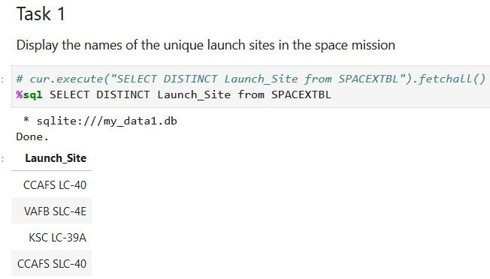
All Launch Site Names
Find the names of the unique launch sites
Used DISTINCT to select unique launch sites
from the SPACEXTBL.

Slide 28
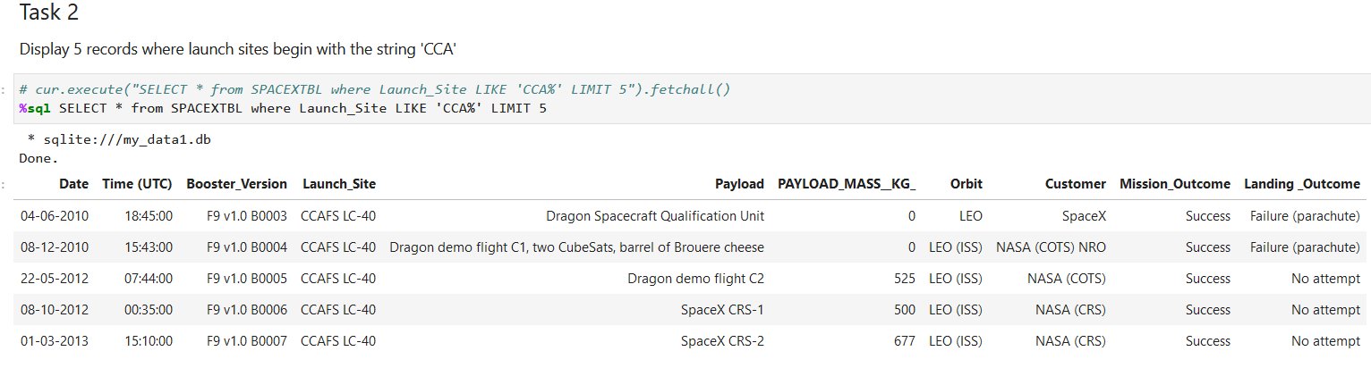
Launch Site Names Begin with 'CCA'
Find 5 records where launch sites begin with `CCA`
Used LIKE in where clause with ‘%’ to find 5 records starts with ‘CCA’ using LIMIT.

Slide 29
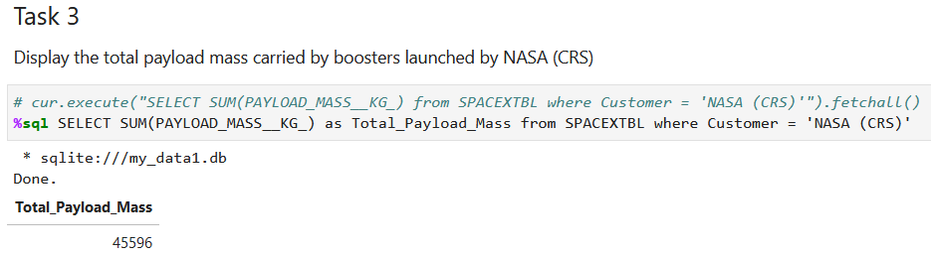
Total Payload Mass
Calculate the total payload carried by boosters from NASA
Used SUM to calculate total payload mass for the customer NASA (CRS) from SPACEXTBL

Slide 30
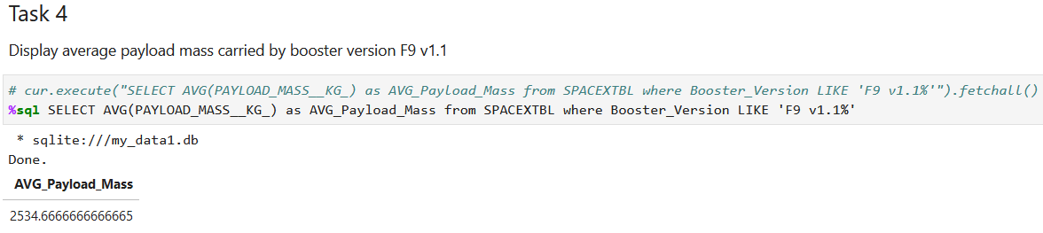
Average Payload Mass by F9 v1.1
Calculate the average payload mass carried by booster version F9 v1.1
Used AVG to find average payload mass for booster version F9 v1.1 from SPACEXTBL

Slide 31
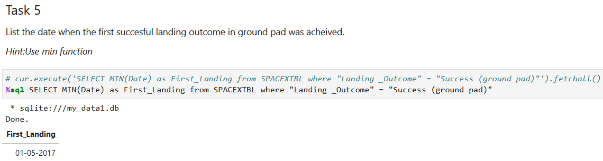
First Successful Ground Landing Date
Find the dates of the first successful landing outcome on ground pad
Used MIN to find first date on which landing outcome on the ground pad was a success.

Slide 32
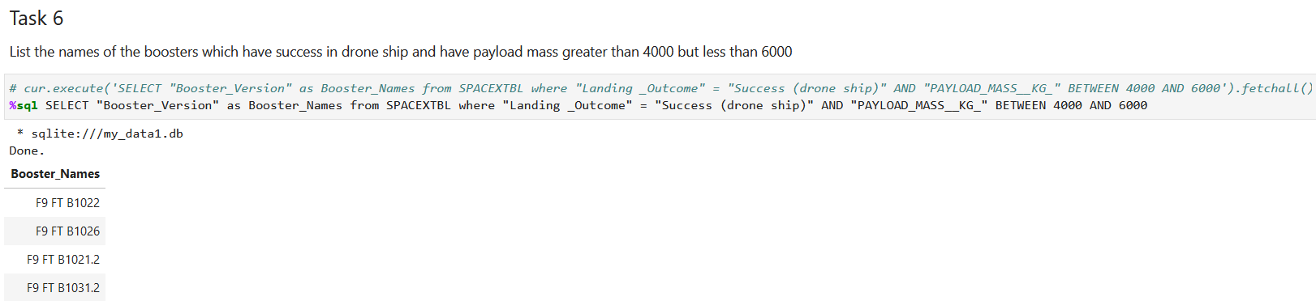
Successful Drone Ship Landing with Payload between 4000 and 6000
List the names of boosters which have successfully landed on drone ship and had payload mass greater than 4000 but less than 6000
Used AND and BETWEEN operators to find boosters with payload in between 4000 and 6000, and it was landed successfully on a drone ship.

Slide 33
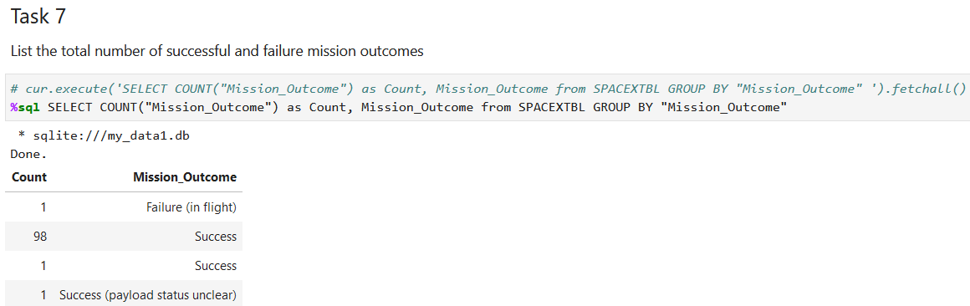
Total Number of Successful and Failure Mission Outcomes
Calculate the total number of successful and failure mission outcomes
Used COUNT and GROUP BY to find each output class and respective number of results from the table SPACEXTBL

Slide 34
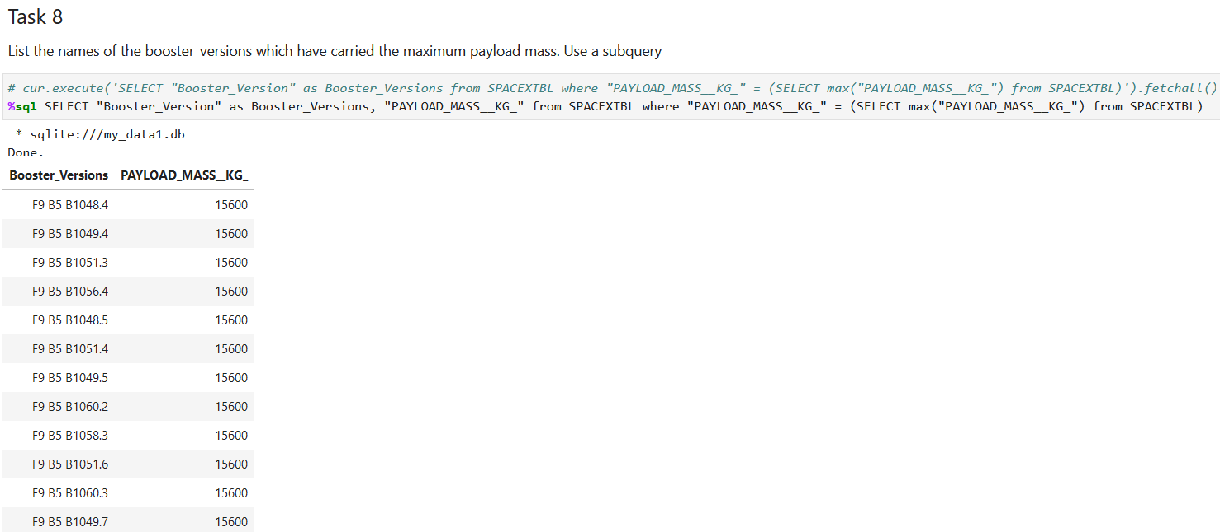
Boosters Carried Maximum Payload
List the names of the booster which have carried the maximum payload mass
Used subquery and MAX operator to obtain the booster versions which have maximum payload mass from the table SPACEXTBL.

Slide 35
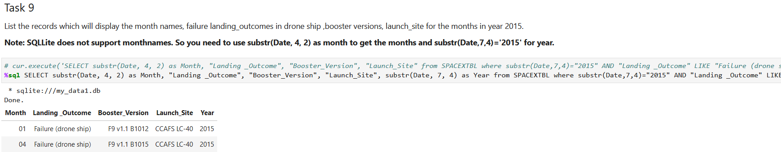
2015 Launch Records
List the failed landing_outcomes in drone ship, their booster versions, and launch site names for in year 2015
# cur.execute('SELECT substr(Date, 4, 2) as Month, "Landing _Outcome", "Booster_Version", "Launch_Site" from SPACEXTBL where substr(Date,7,4)="2015" AND "Landing _Outcome" LIKE "Failure (drone ship)"').fetchall()
%sql SELECT substr(Date, 4, 2) as Month, "Landing _Outcome", "Booster_Version", "Launch_Site", substr(Date, 7, 4) as Year from SPACEXTBL where substr(Date,7,4)="2015" AND "Landing _Outcome" LIKE "Failure (drone ship)“
Used substr for dates, AND and LIKE operators for landing outcome type to be failure on drone ship.

Slide 36
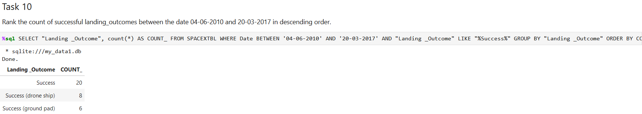
Rank Successful Landing Outcomes Between 2010-06-04 and 2017-03-20
Rank the count of successful landing outcomes between the date 2010-06-04 and 2017-03-20, in descending order
%sql SELECT "Landing _Outcome", count(*) AS COUNT_ FROM SPACEXTBL WHERE Date BETWEEN '04-06-2010' AND '20-03-2017' AND "Landing _Outcome" LIKE "%Success%" GROUP BY "Landing _Outcome" ORDER BY COUNT_ DESC
Used GROUP BY and ORDER BY to obtain a descending order list of landing outcome with respective count.

Slide 37

Section 3

Slide 38
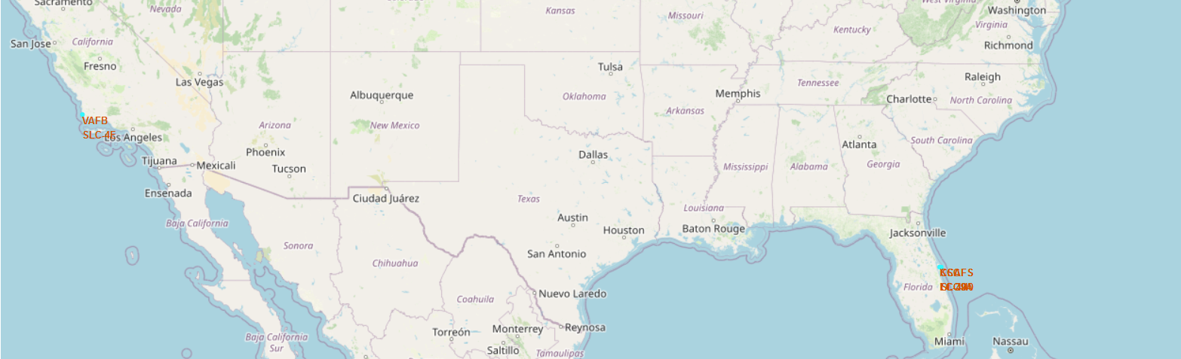
Launch Sites Markers on a Global Map
All launch sites are near coastline and to the equator.

Slide 39
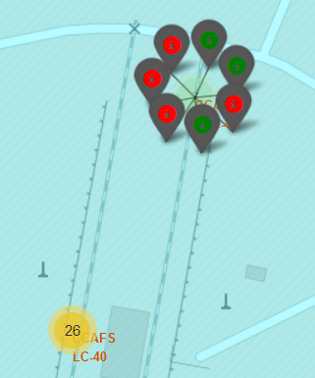
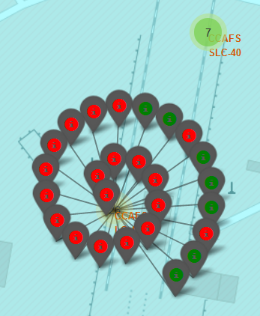
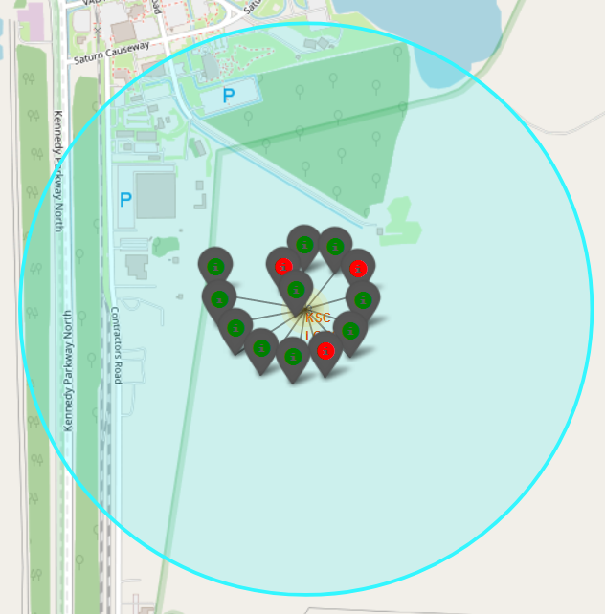
CCAFS SLC-40
CCAFS LC-40
KSC LC-39A
Launch Outcomes for Each Site in Florida
As per the map, launch site KSC LC-39A has relatively higher success rate as compared to CCAFS SLC-40 and CCAFS LC-40.

Slide 40
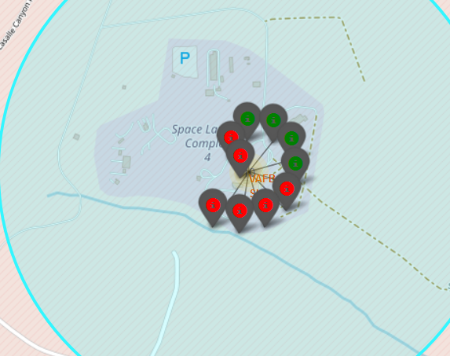
Launch Outcomes for VAFB SLC-4E in California
As compared to KSC LC-39A in Florida, VAFB SLC-4E launch site has relatively lower success rate of nearly 40%.

Slide 41
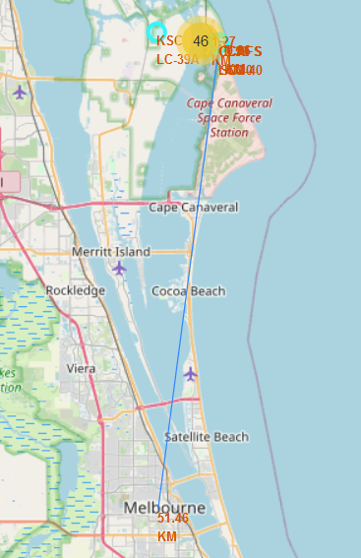
Distance From Closest City
Closest metro city from the launch site CCAFS SLC-40 is Melbourne at a distance of ~ 51 KM.
It is so to keep mass from harm's way in case of some accidents and to maintain security of the site by preventing access of unauthorized.

Slide 42
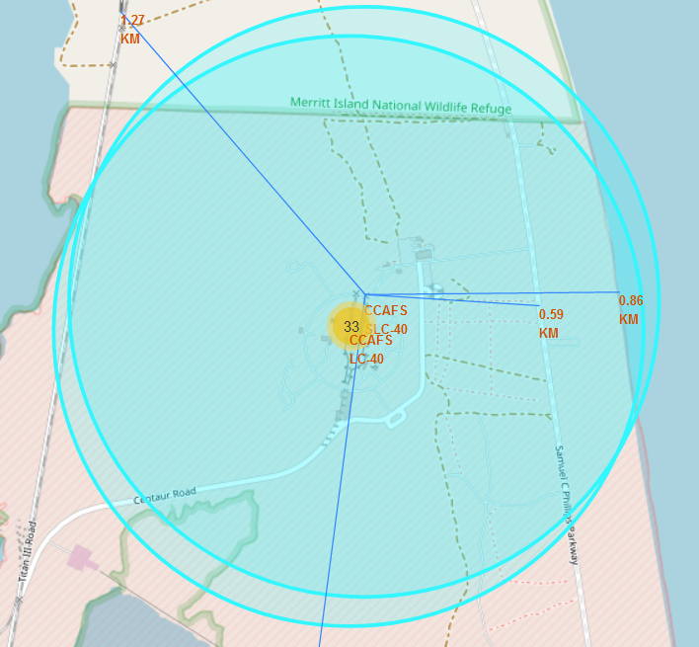
Distance From Launch Site to Other Proximities
From CCAFS SLC-40:
Closest Rail Line: 1.27 KM
Closest Highway: 0.59 KM
Closest Coast Line: 0.86 KM

Slide 43

Section 4

Slide 44
All Launch Sites Success Ratio
KSL LC-39A has the highest launch success ratio of 41.7% followed by CCAFS LC-40 with 29.2% success ratio. In contrast, CCAFS SLC-40 has the lowest success ration of 12.5%.

Slide 45
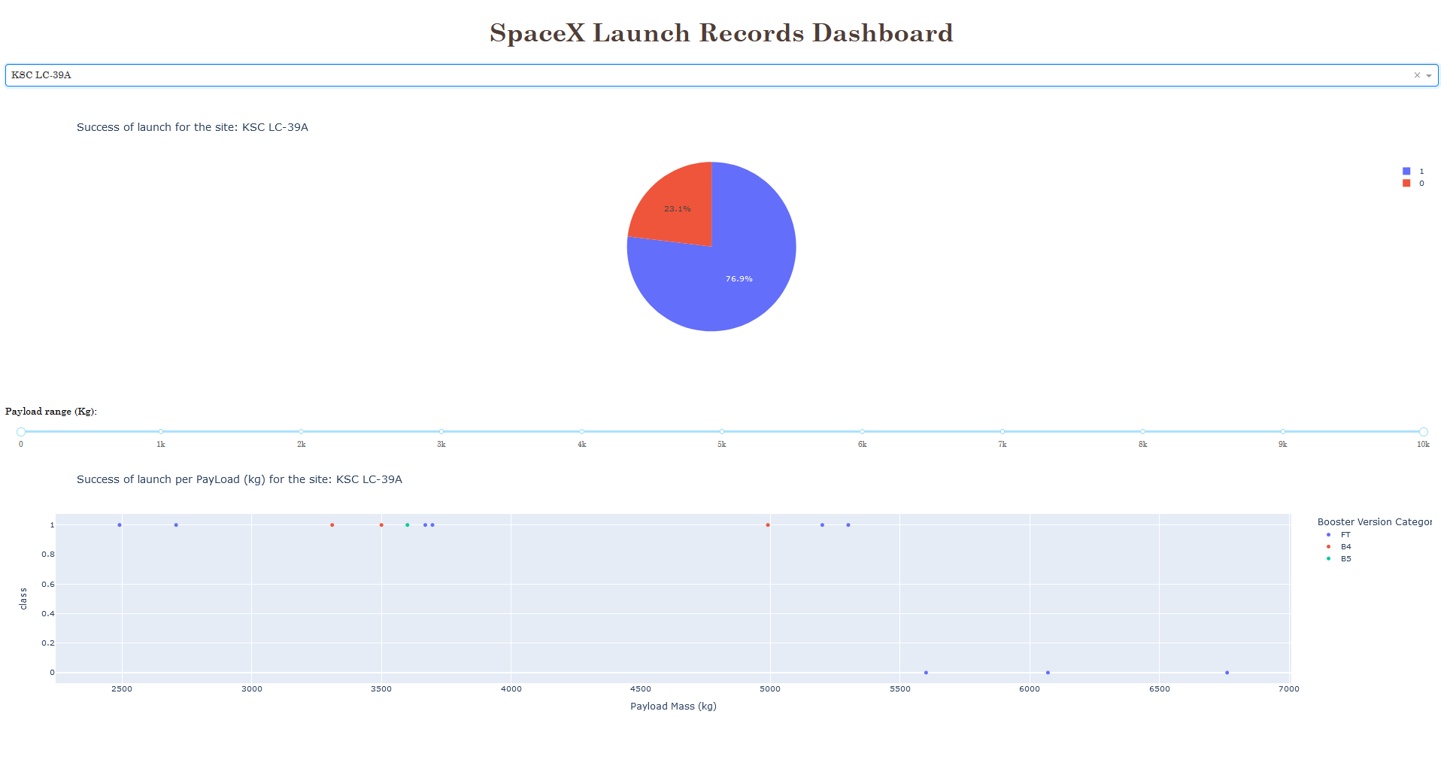
Pie-chart Of The Site With Highest Launch Success Ratio
The pie-chart depicts the result of the launch site KSL LC-39A.
As per the observation we can deduce the fact that the success ratio is of 76.9%.
The scatter plot shows the payload carried by all launches from the site and their result (1 – Success or 0 - Failure)

Slide 46
Scatter Plot of Payload vs Launch Outcome
Observation:
Booster version FT has the highest success ratio among all the versions.
The range of payload carried and resulted in a success for the booster FT is in between 2000 kg to 6000 kg.

Slide 47

Section 5

Slide 48
Classification Accuracy
All the classification models performed equally well on the testing data.
Overall accuracy obtained was same across all the models which is 83.34%.

Slide 49
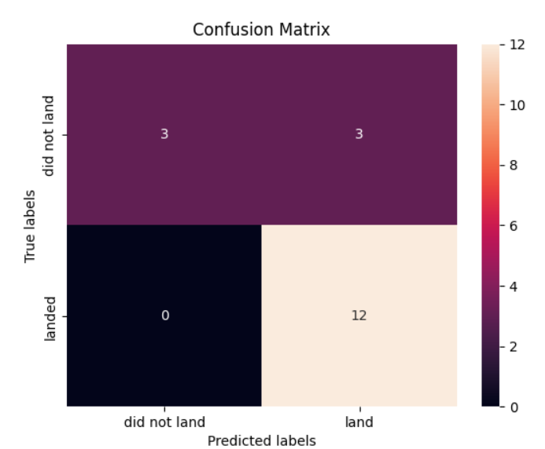
Confusion Matrix
Confusion matrix remained the same across all the classification models as they distinguished results equally in each class.
However, all the models did the same error while predicting outcome when launches were not a success and the results predicted were that of a success. (false positive).

Slide 50
Conclusions
The success rate of launches at launch sites KSC LC-39A and CCFS SLC-40 significantly improves as the flight number increases. After the 77th flight, the success rate reaches 100% at these sites. Similarly, at launch site VAFB SLC-4E, the success rate reaches 100% after the 50th flight.
When it comes to heavy payloads, the landing success rate is notably higher for missions targeting polar orbits, low Earth orbits (LEO), and the International Space Station (ISS). However, in the case of Geostationary Transfer Orbits (GTO), it is challenging to differentiate the success of landings accurately. This is because both positive landing rates (successful missions) and negative landing rates (unsuccessful missions) exist for GTO missions.
Note that the success rate since 2013 kept increasing till 2020.
According to the data presented on the map, launch site KSC LC-39A exhibits a comparatively higher success rate compared to CCAFS SLC-40, VAFB SLC-4E, and CCAFS LC-40.
Based on the data provided, KSC LC-39A has the highest launch success ratio, standing at 41.7%. Following closely is CCAFS LC-40 with a success ratio of 29.2%. In contrast, CCAFS SLC-40 has the lowest success ratio of 12.5%.

Slide 51
Conclusions (Cont.)
While KSC LC-39A may have the highest overall success ratio, it is worth noting that this launch site did not perform well with heavy payloads. Specifically, launches with payloads exceeding 5500 kg resulted in failures at this site.
Among all the booster versions, the FT version has the highest success ratio. The payload range carried by the FT booster that resulted in a successful mission falls between 2000 kg and 6000 kg.

Slide 52


